Slide 1
BIGFISH Moprhometrics and Discriminant Analysis
Cormac Nolan
01 June 2016

Slide 2
Morphometrics

Slide 3
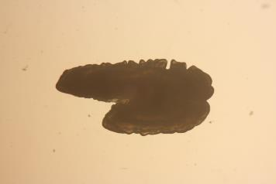

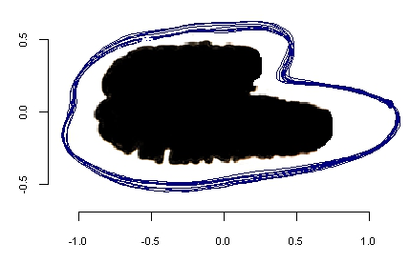
Otolith Shape: Elliptic Fourier Anaysis (EFA)

Slide 4
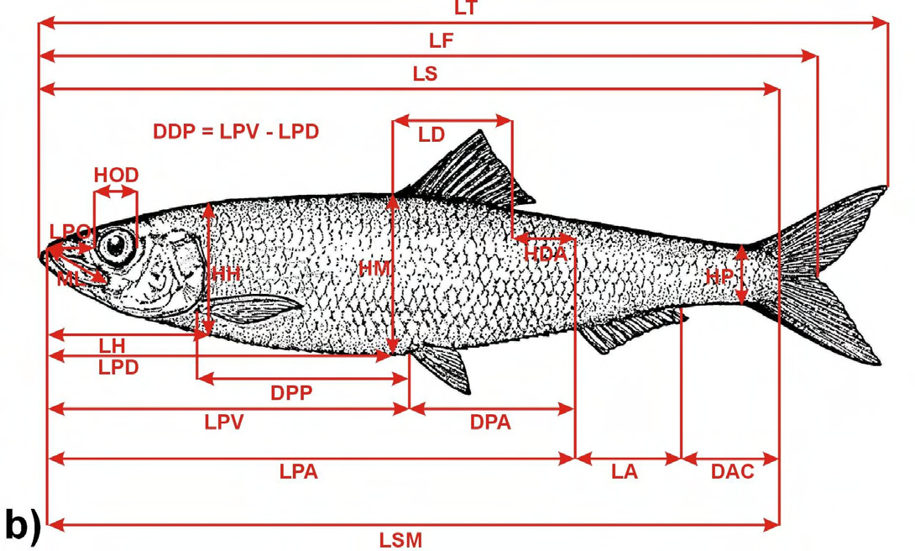
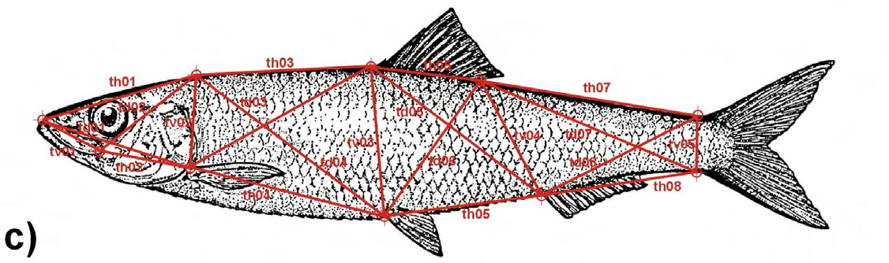
Body Morphology

Slide 5
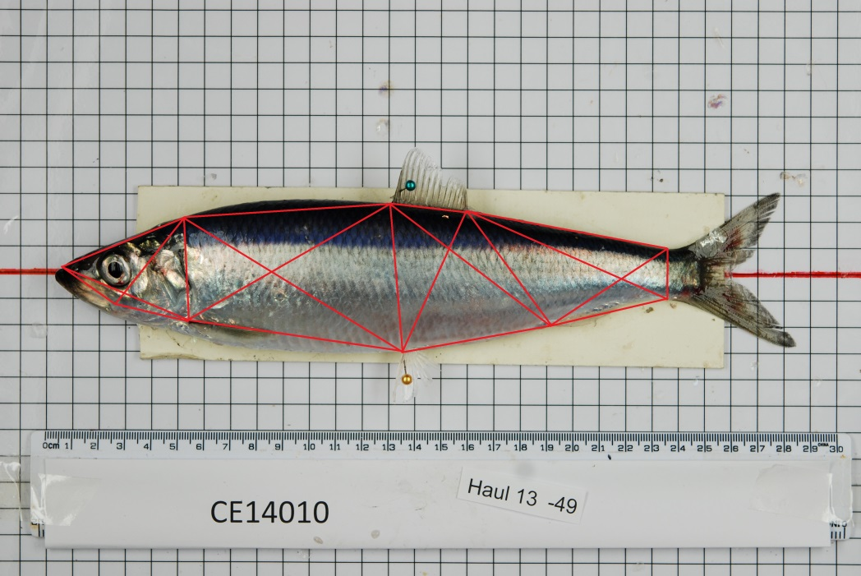

Slide 6
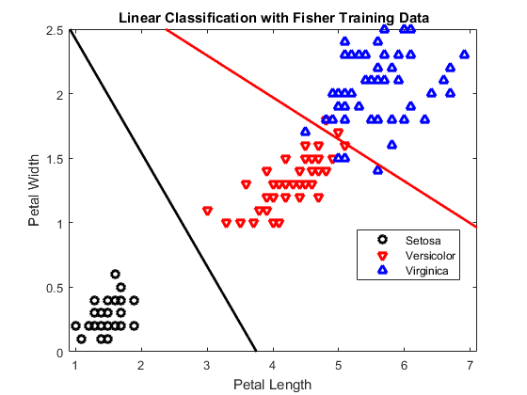
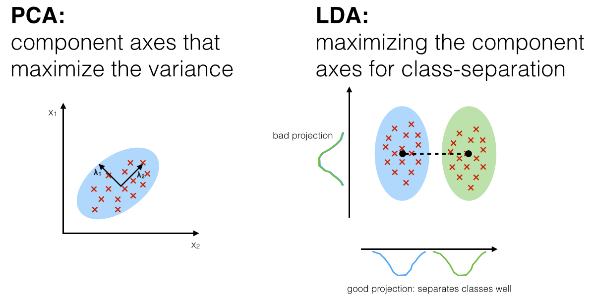
Discriminant Analysis
Used to categorise the unknown based on a training dataset

Slide 7
Other machine\statistical learning methods
Logistic regression
K-nearest neighbour (simple concept)
Random forests
Support vector machines (best out of the box)
Choice will depend on the situation and the data, no one method is a clear winner in all situations

Slide 8
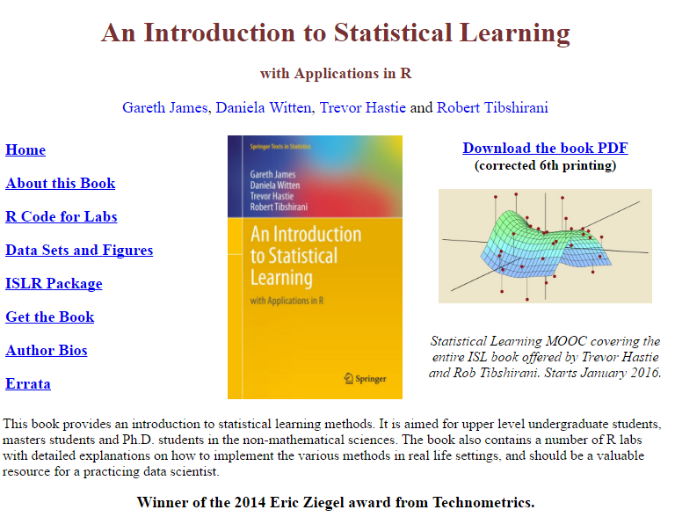
http://www-bcf.usc.edu/~gareth/ISL/ISLR%20Sixth%20Printing.pdf

Slide 9
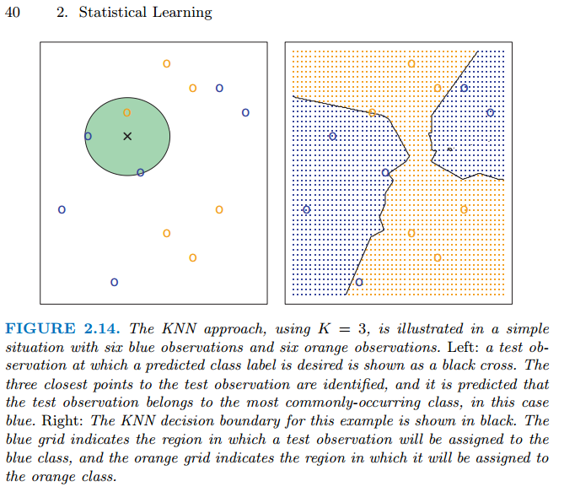

Slide 10
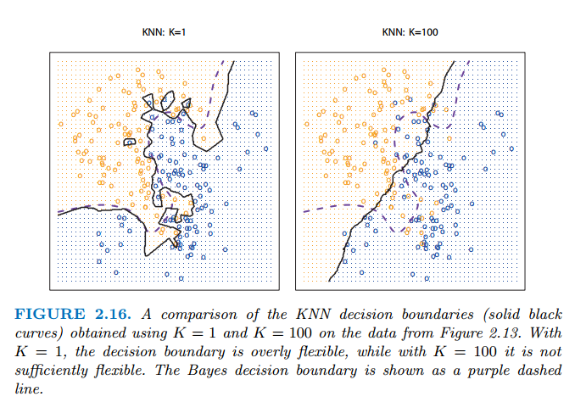

Slide 11
